Slide 1
Disclaimer
This training resource was developed to be used with the CZ ID platform
In October, 2026, stewardship of CZ ID transitioned to UCSF and the platform was renamed to SeqtoID
These training materials are not being actively maintained and may not reflect differences between CZ ID and SeqtoID, subsequent changes to the platform, or current methods and best practices in metagenomic sequencing and analysis

Slide 2

Quality Control Overview and Interpretation
Rapid Response – Updated Sept 2026
Notes:
Slides updated 07/02/2024

Slide 3
Outline
QC metric definitions
How QC metrics help inform wet lab experiments and data interpretation
Perform QC within CZ ID (look at your data!)

Slide 4
Quality Control
Were there enough reads?
Did my samples pass QC filtering? (basecall quality, length, complexity)
How many reads were removed during data preprocessing? (e.g., host filtering)
How many reads were used for microbe identification (i.e., passed filters)?

Slide 5
CZ ID QC Metrics
Total Reads: Total reads uploaded to the pipeline.
Passed QC: Reads that passed quality filters (fastp).
Passed Filters: Reads used for analysis (i.e., reads that passed QC, host/human filtering, and subsampling).
Duplicate Compression Ratio (DCR): Ratio of sequences present prior to duplicate removal vs after duplicate removal (e.g. over-amplification, over-sequencing).
ERCC Reads: Total number of reads mapping to ERCC internal controls (RNA-seq).
Mean insert size: Average length of the nucleotide sequence that is inserted between adapters (human samples only).
Notes:
We like DCR < 3

Slide 6
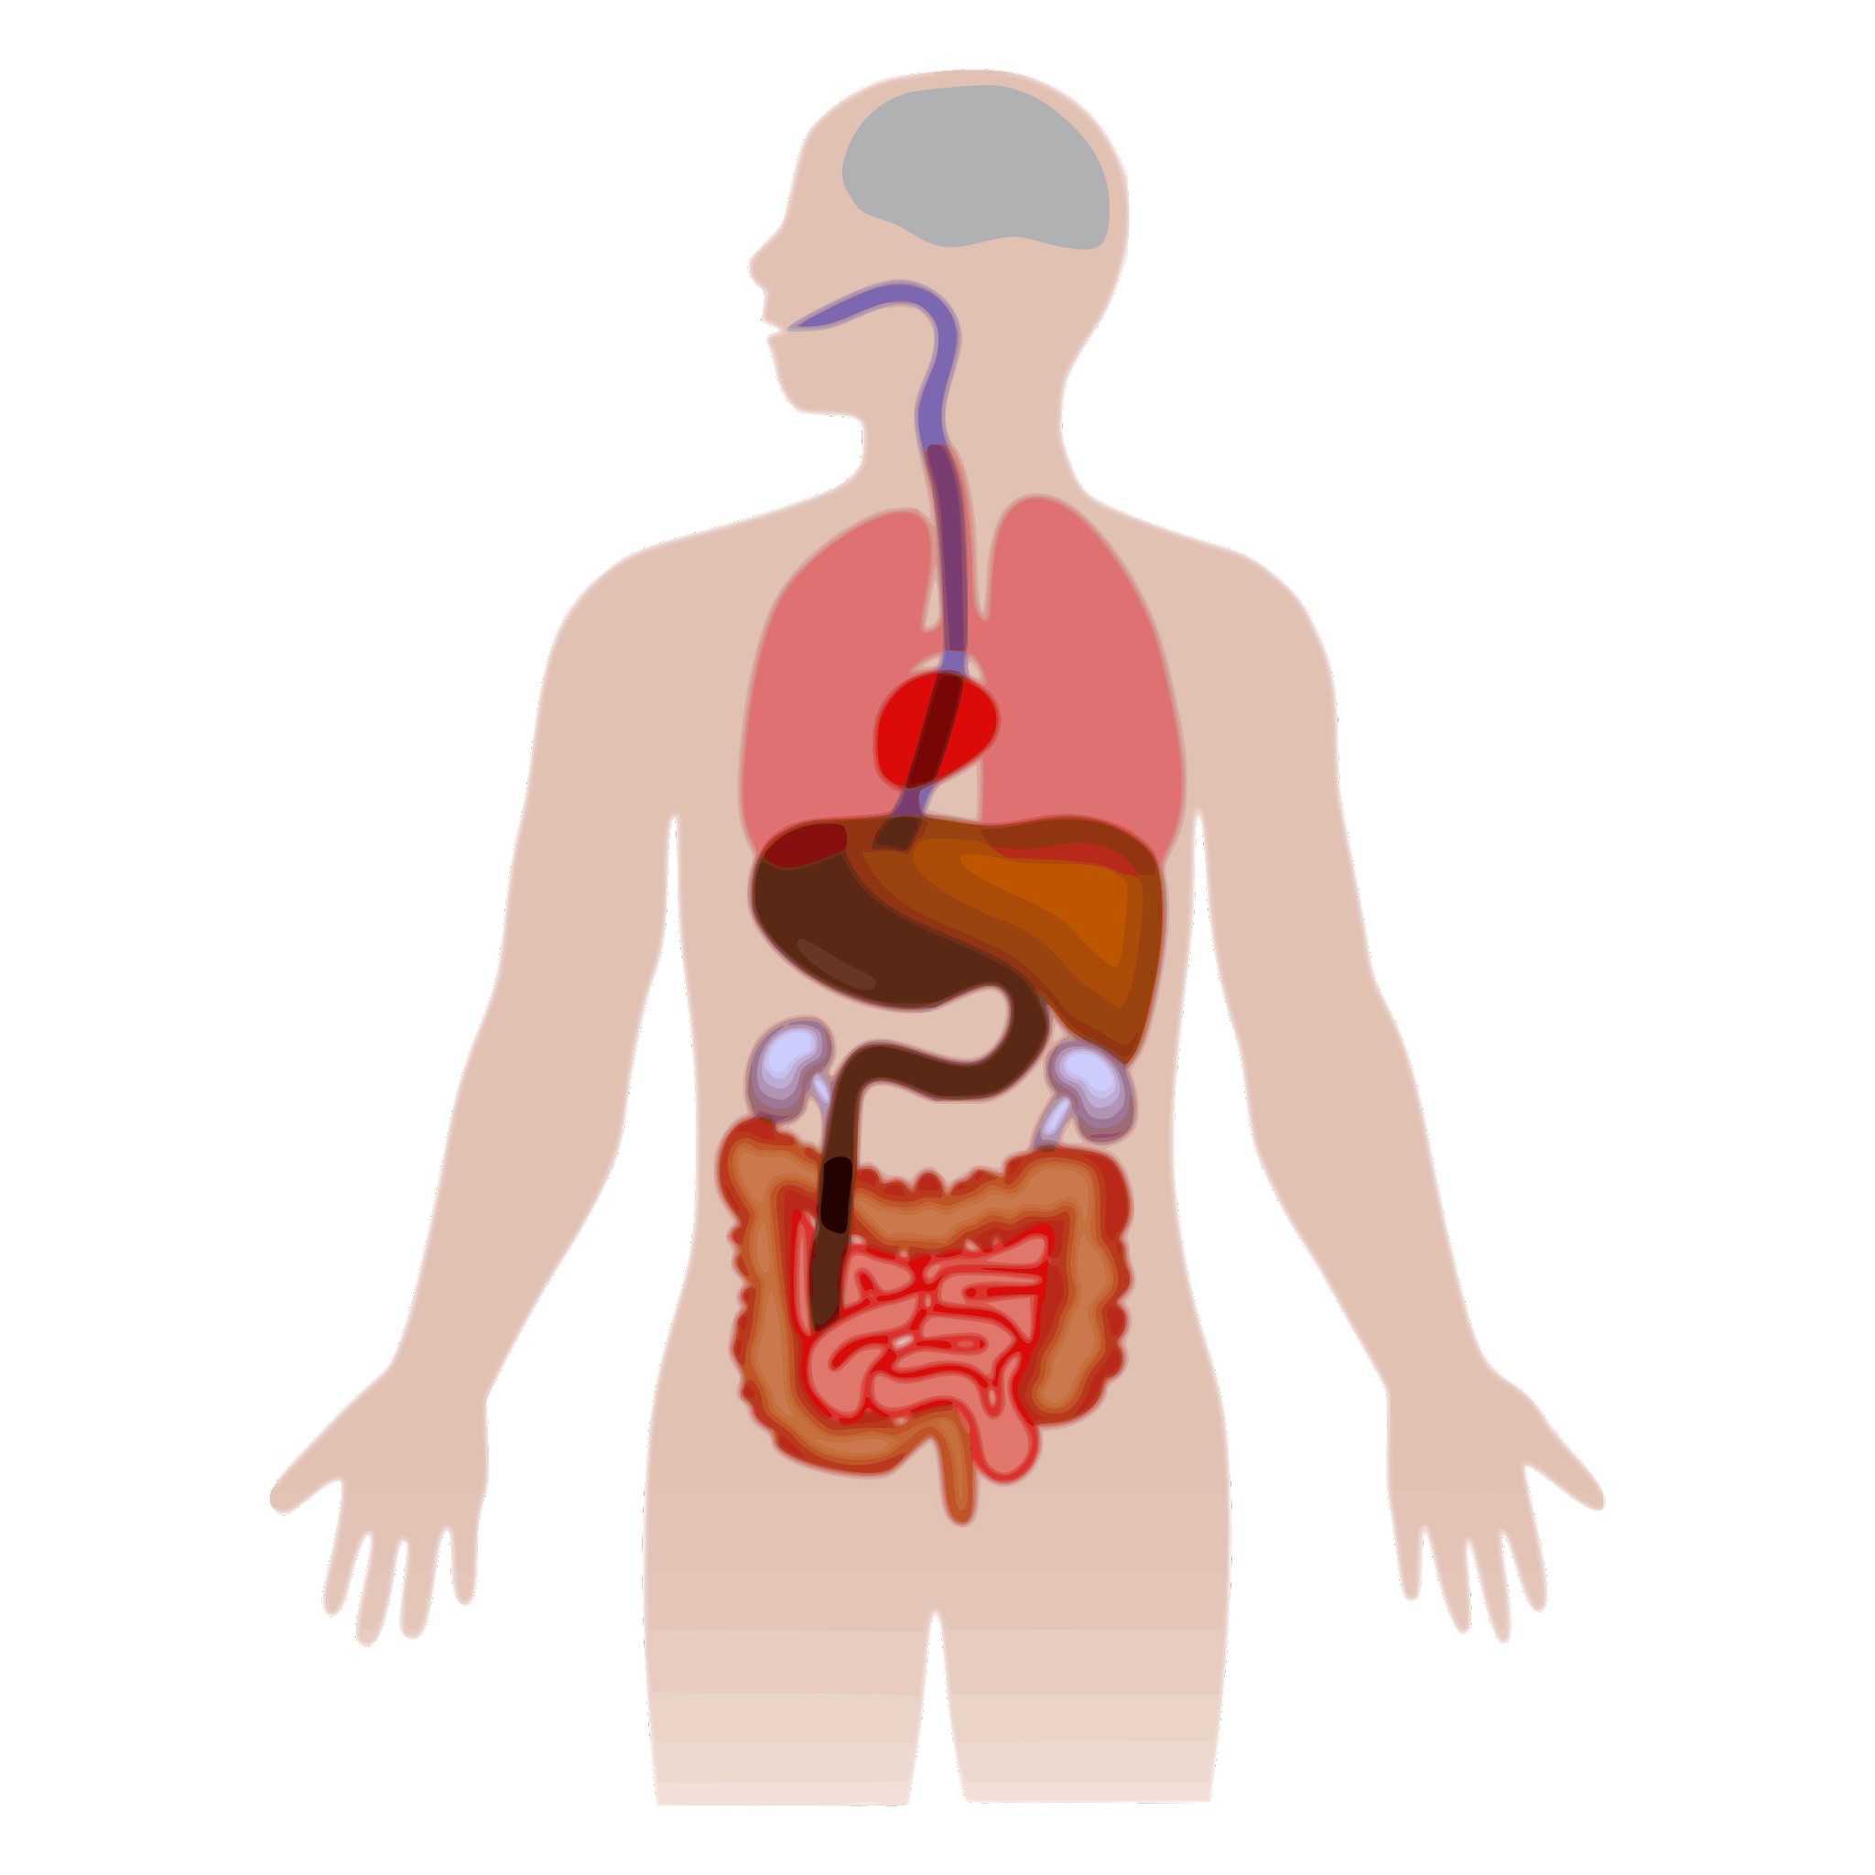
Sample type matters when evaluating QC metrics
Sample Type | Host Signal | Microbial Signal
CSF | > 99% | << 5% with infection
Tracheal Aspirate | 95% | 5%
Nasal or oral | 50% | 50%
Whole blood | > 99% | << 1% (with infection)
Rectal or Vaginal | 50% | 50%
Host
Microbial
Adapted from CZ BioHub mNGS Intro
Notes:
Different sample types have different RNA content host vs microbiome vs pathogen

Slide 7
QC metrics affected by sample type
Sample Type | Typical Distribution | QC Trend
Stool, NP Swab, Environmental Samples, Sputum, Urine (Higher diversity & DNA/cDNA input) |  | Higher microbial reads Lower DCR
Serum, CSF, Plasma, Negative Controls (Lower diversity & DNA/cDNA input) |  | Lower microbial reads Higher DCR (PCR artifact) Higher background contamination
Host
Microbial
ERCC
host
microbe
ERCC

Slide 8
QC metrics not affected by sample type
% Passed QC (fastp)
  Should not inherently vary by tissue type
    Per base quality (Q score)
    Adapter dimer
    Length
    Complexity
  May require knowledge of sample processing for interpretation
Total reads
  Not affected by sample type
  Dependent on input DNA/cDNA and sequencing depth

Slide 9
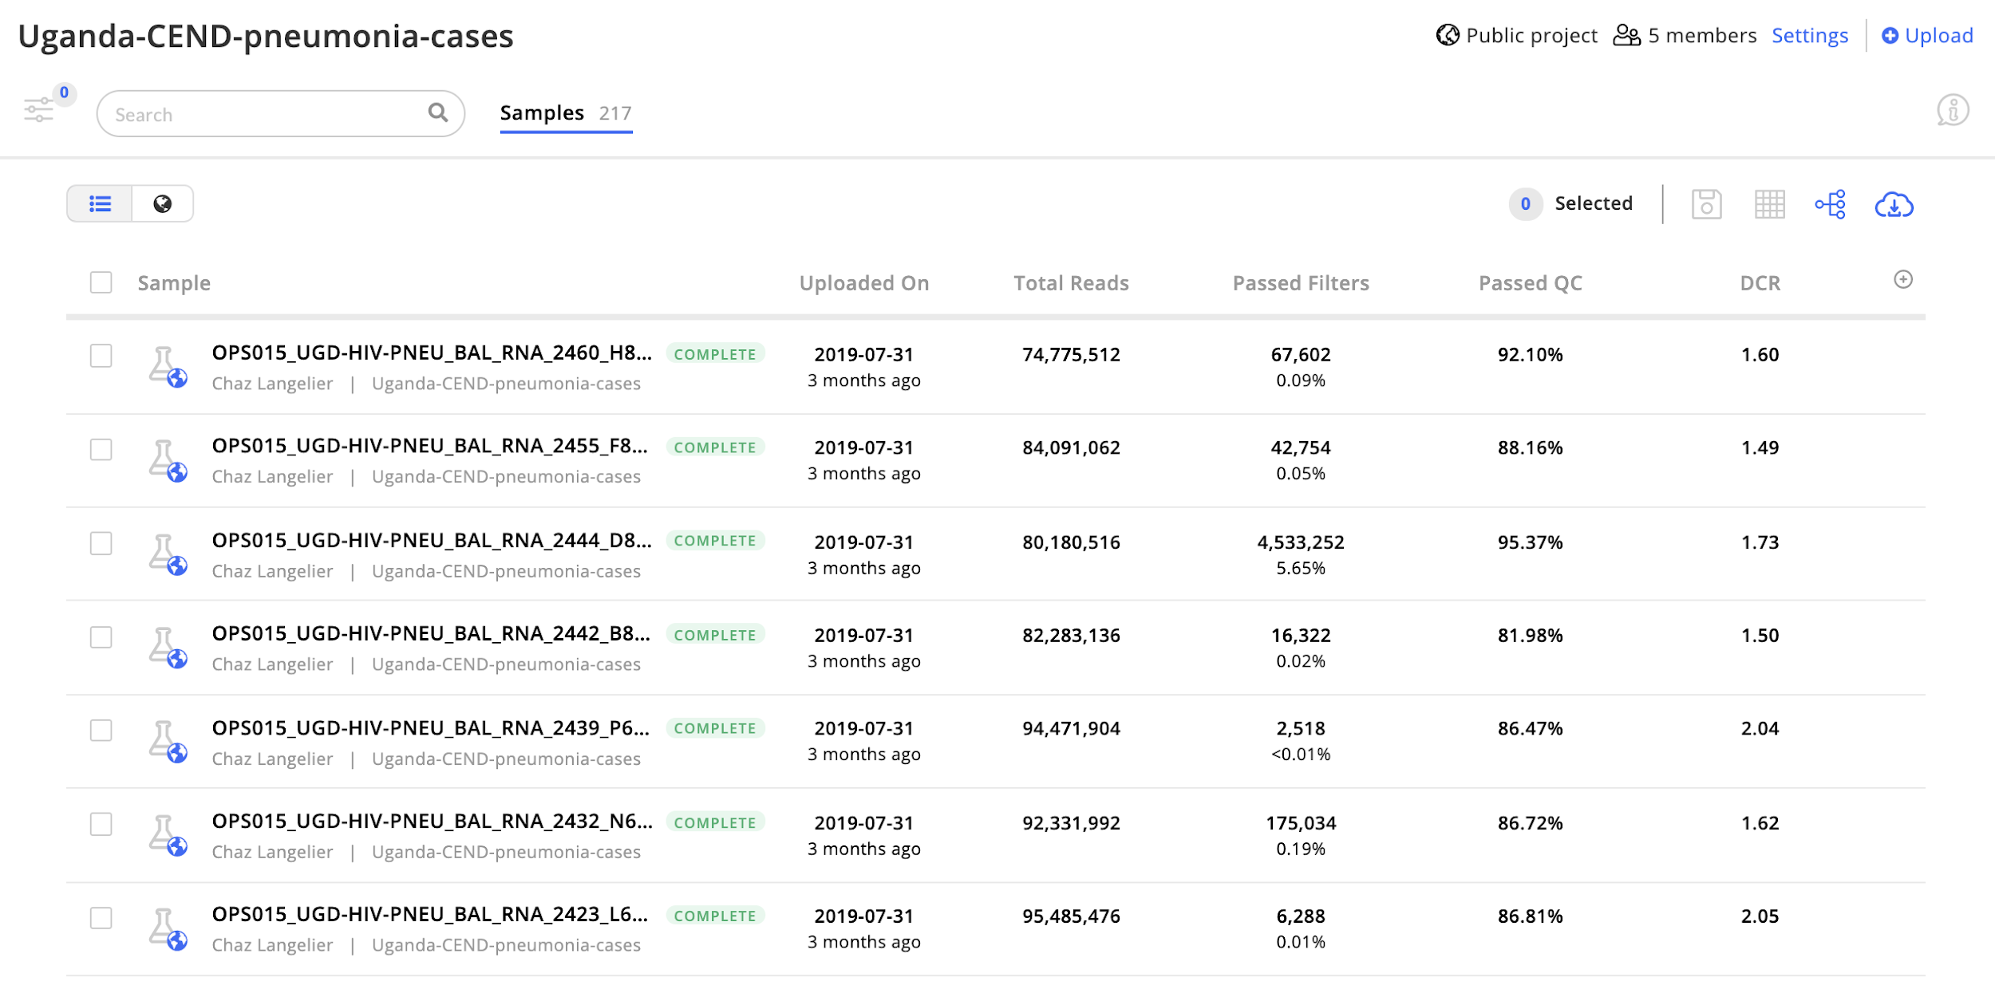
Quality metrics on the Project page
(Sample Table)
Notes:
Reminder that ‘+’ can be used to adjust metrics shown.

Slide 10
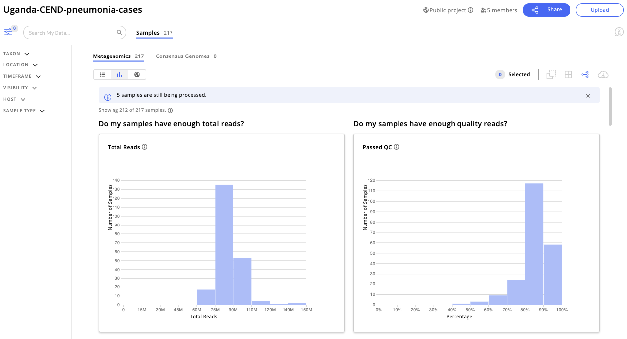
Project-level QC
Notes:
Explain axes (histogram view)

Slide 11
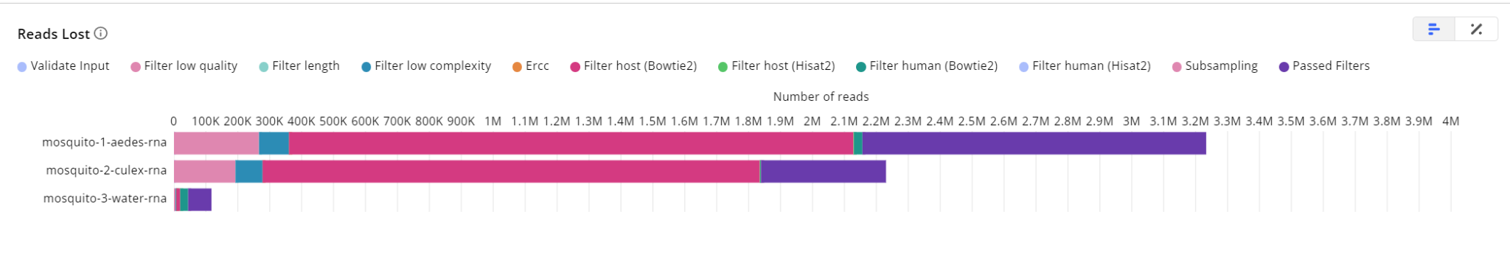
Project level QC - reads lost
Mosquito
Notes:
Different colours represent different QC steps in the pipeline.

Slide 12
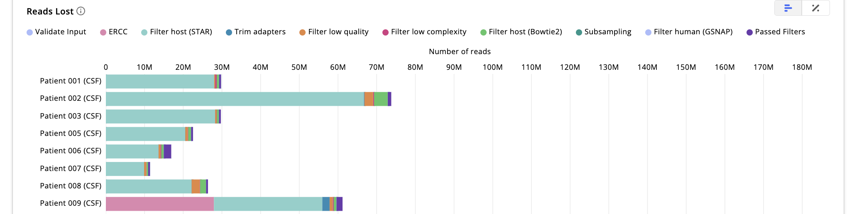
Project level QC - reads lost
Mosquito
CSF
Notes:
Comparison of different sample types.

Slide 13
Reads Lost Interpretation
Pipeline Step | Function | If Many Reads Lost During this Step...
fastp | Filter length Filter low quality reads Filter low complexity reads | Many short reads (possible adapter dimers, degradation, and/or over-fragmentation). Many reads of low-quality (low phred scores, GC content, over-clustering) Reads are relatively low-complexity (contain homopolymer nucleotide runs or simple sequence repeats)
Bowtie2, HISAT2 | Filter host reads | Large proportion of reads mapped to the host genome
Bowtie2, HISAT2 | Filter human reads (regardless of host) | Large proportion of reads mapped to the human genome
Notes:
Tie into wet lab work.

Slide 14
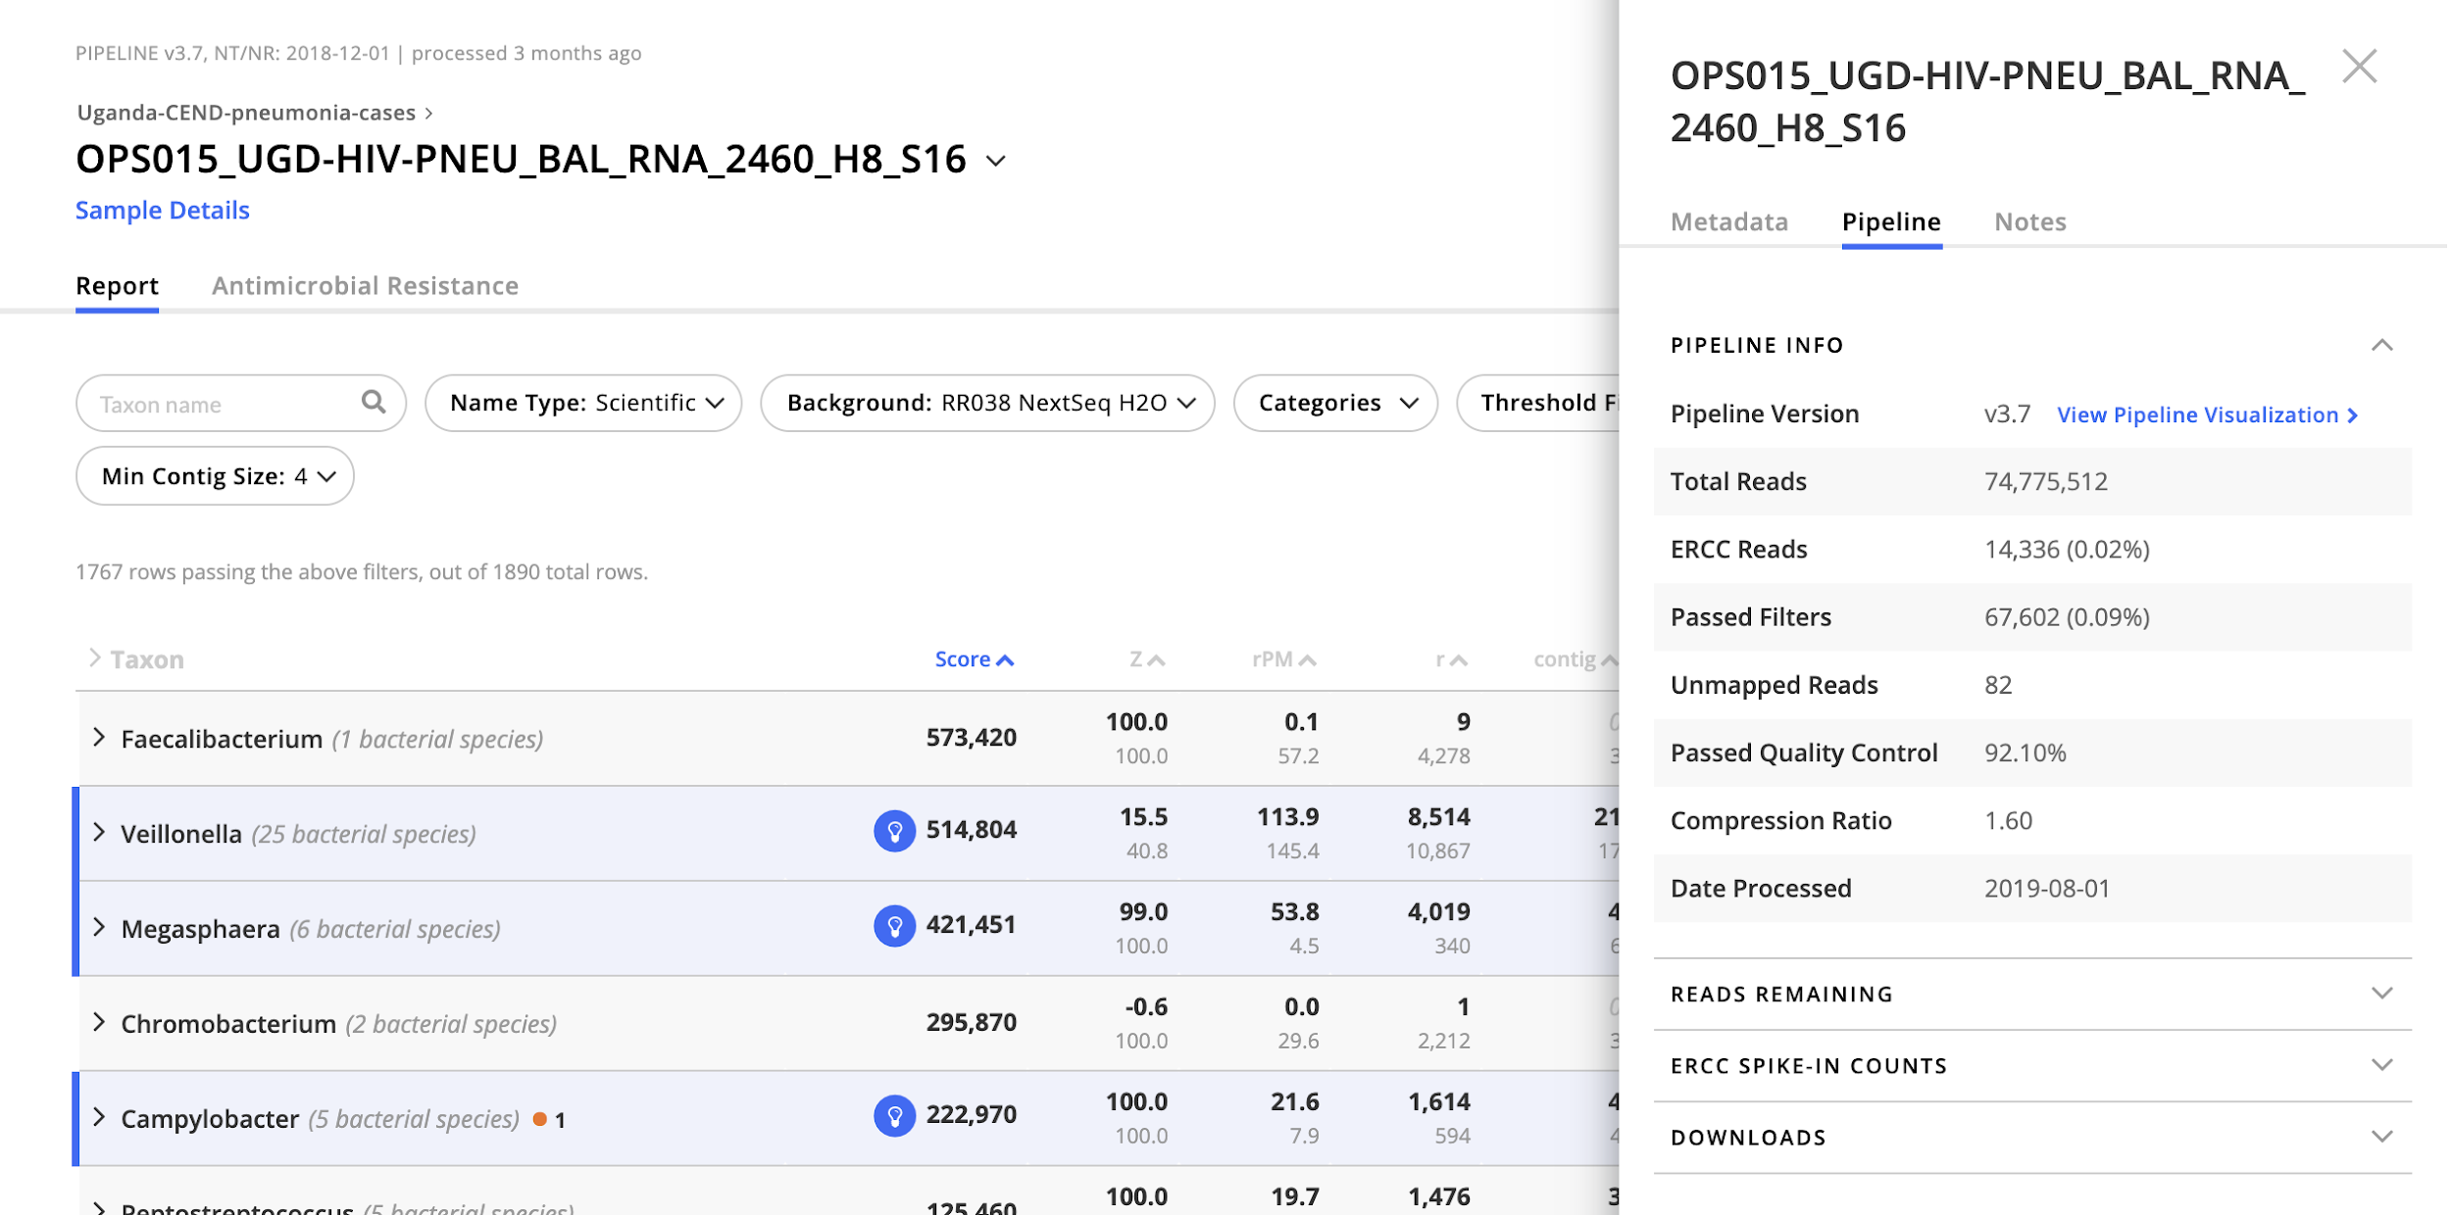
Sample-level QC

Slide 15
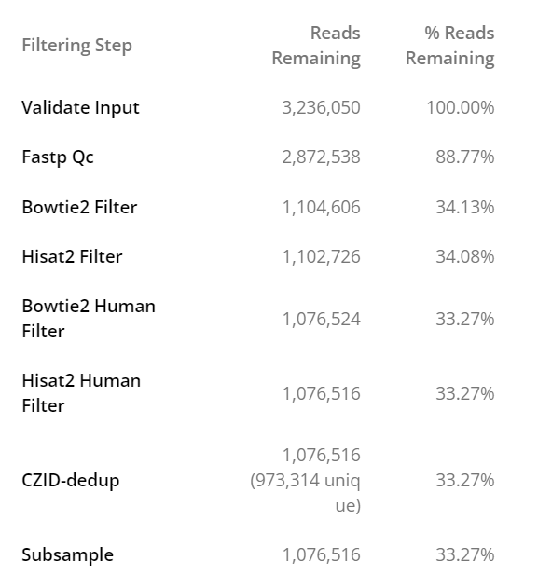
Sample-level QC

Slide 16
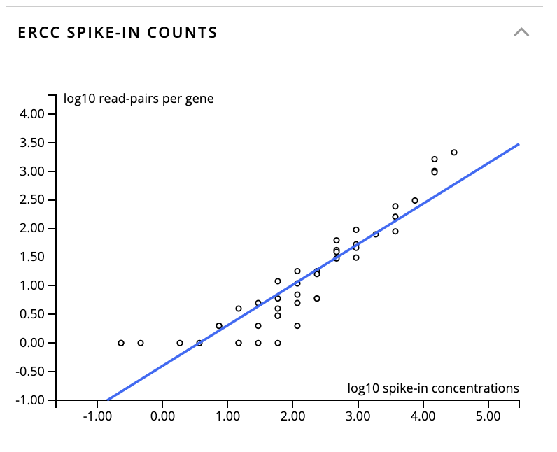
Sample-level QC
Notes:
ERCC can be used to estimate input RNA for low biomass samples (input_pg = ercc_pg / ercc_reads * (total_reads - total_ercc_reads)

Slide 17
What are ERCC’s?
ERCCs = External RNA Controls Consortium
Pre-mixed, commercially available blend of 92 synthetic RNA transcripts
Positive control for library preparation, spiked into all samples and water controls
Can be used to estimate input RNA concentration
Notes:
Good or bad?

Slide 18
What are ERCC’s?
ERCC = External RNA Controls Consortium
Pre-mixed, commercially available blend of 92 synthetic RNA transcripts
  Designed to be distinct from RNA found in samples
Positive control for library preparation, spiked into all samples and water controls
Can be used to estimate input RNA concentration
  If we know # of pg of ERCC input and we get out # of reads of ERCC, then we can calculate a (reads per pg of input) factor

Slide 19
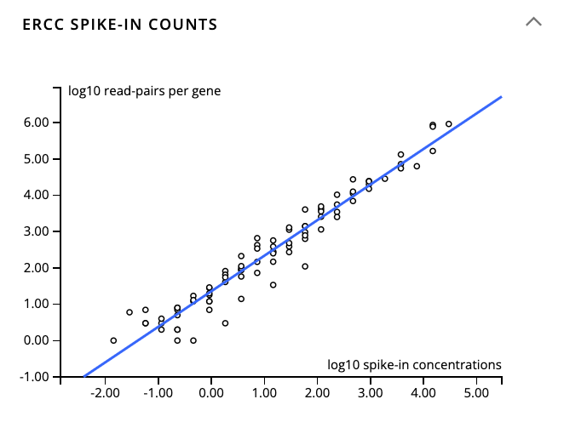
ERCC Plot Examples
Notes:
Good or bad?

Slide 20
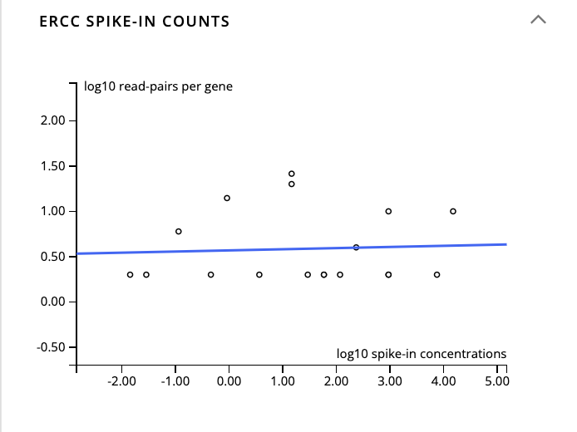

ERCC Plot Examples
Notes:
Good or bad?

Slide 21
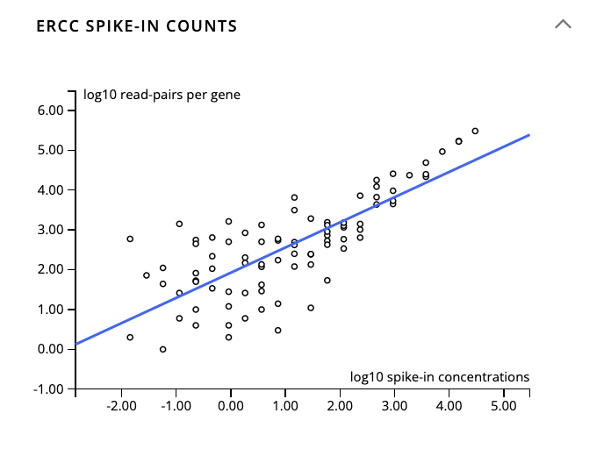
ERCC Plot Examples
Notes:
Good or bad?

Slide 22
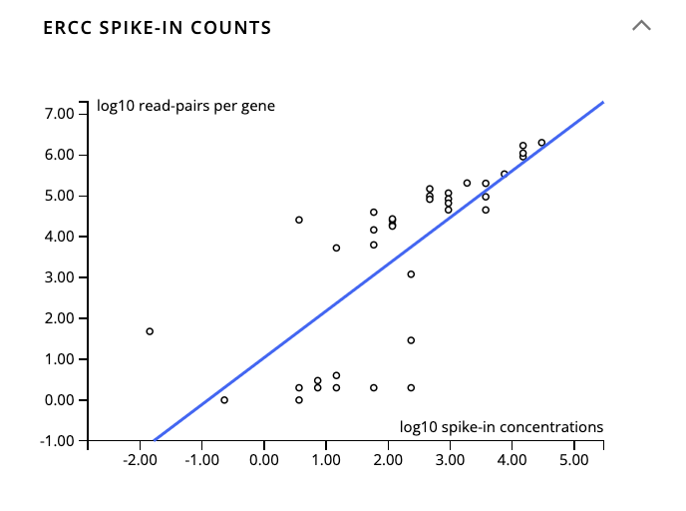
ERCC Plot Examples
Notes:
Last example: ERCCs made 40% of total reads (7.5M ERCC reads)

Slide 23
ERCC Plot Examples
Notes:
Last example: ERCCs made 40% of total reads (7.5M ERCC reads). When in doubt, use standard background model!

Slide 24
Let’s perform QC together!

